Slide 1
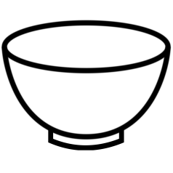
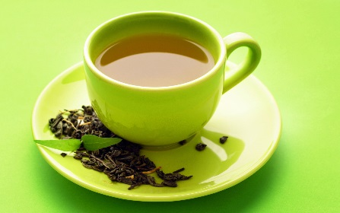
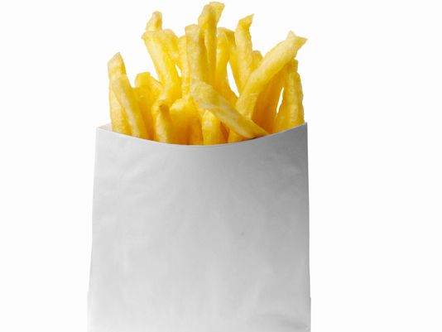
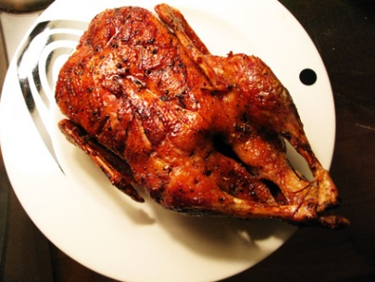
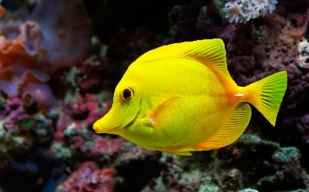
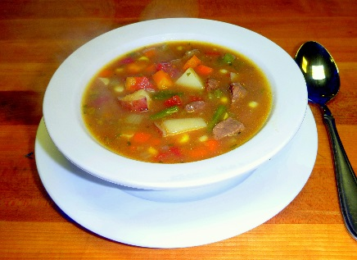
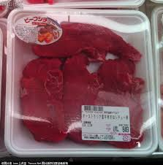
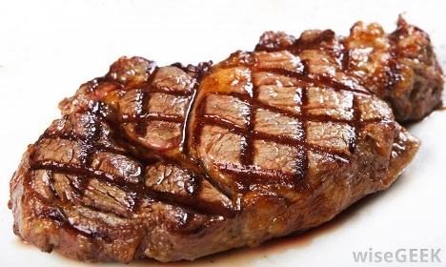
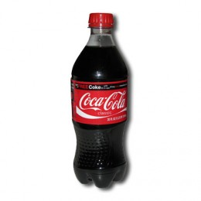
Write it on your paper and turn it in before you leave today.
杯碗条瓶只包斤个

Slide 2
Healthy Diet
健康饮食
1. At least 5 categories. (picture & Characters)
2. At least 3 items in each category. (picture & Characters)
3. You must use: (2 items each)
…要少吃。Eat less…
…要适量吃。Eat…
…要多吃。Eat more…
要少喝… 。Drink less…
要多喝…。 Drink more…
4. You will need to memorize everything and present it to the class next Monday or Tuesday 08/07 or 08/08.
5. QUIZLET “Healthy Diet structures” will help you to pronounce the sentences.

Slide 3
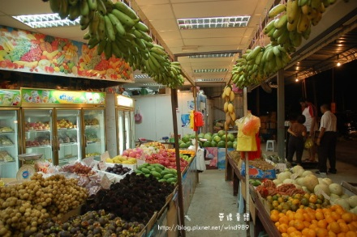
饮食包括：
1.
2.
3.
4.
5.
水果

Slide 4
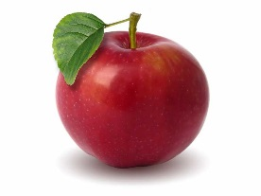
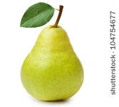
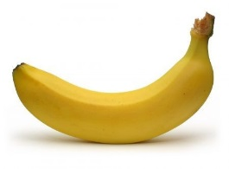
比如：
苹果
1.
2.
3.
4.
5.
水果
梨
香蕉

Slide 5
健康饮食:
…要少吃。Eat less…
…要适量吃。Eat…
…要多吃。Eat more…
要多喝… 。Drink more…
要少喝…。 Drink less…
苹果和梨

