Slide 1
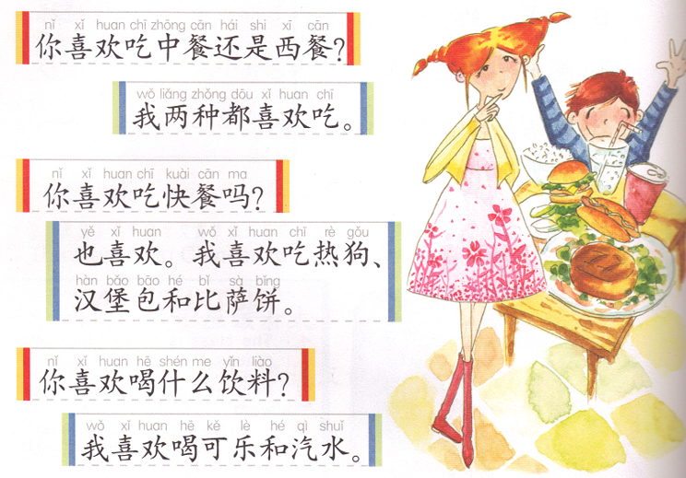
我
DO NOW: Find out the following words from the dialog:
Or
2 kinds/types
Also
Task 1: Read this dialog to Feng with your partner (assigned) 15%

Slide 2
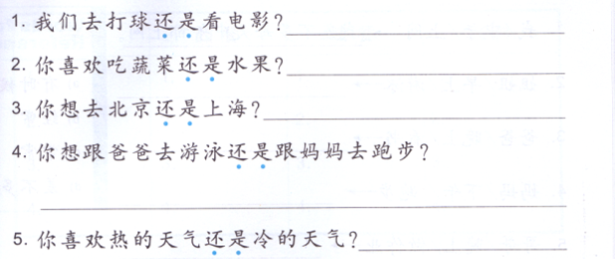
Task 2: Answer the questions in complete sentences, using at least 2 red and 2 green.
我们去A。 Or 我们去B。 Or 我们都去。
我喜欢吃A 。Or 我喜欢吃B。 Or 我都喜欢吃。
我想去 A。 Or 我喜欢去 B。 Or 我都想去。
我想 A。 Or 我想 B。 Or 我都想去。
我喜欢 A。 Or 我喜欢 B。 Or 我喜欢 A 和 B。

Slide 3
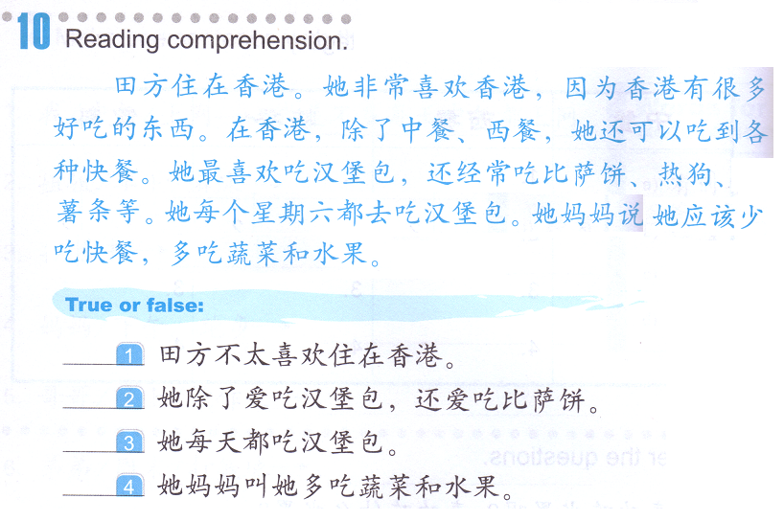
Task 3: True or false and MARK DOWN the REASONS in the paragraph.
Reason:
F
Example:_____田方住在北京。

Slide 4
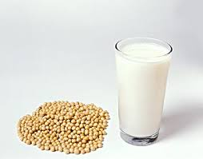
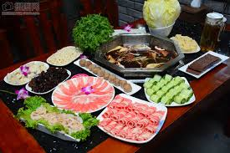
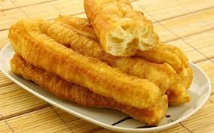
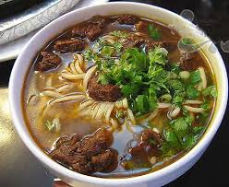
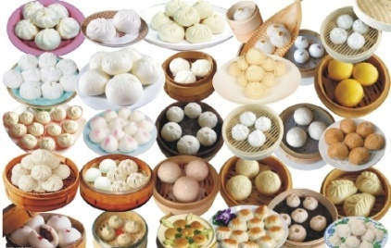
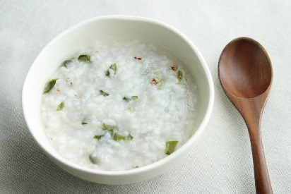
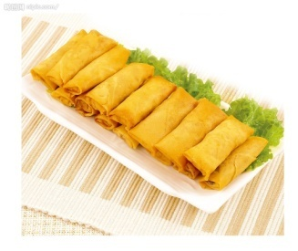
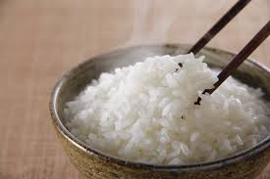
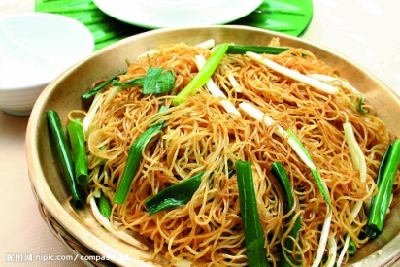
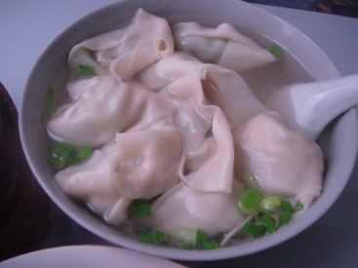
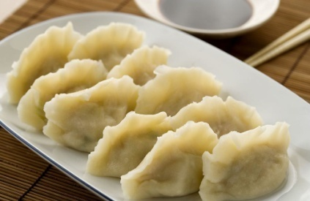
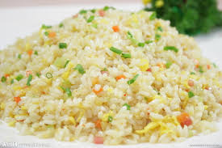
 | 包子 火锅huo guo
 | 粥 zhou
Task 4: ENGLISH
Do some research and explain what the following Chinese food items are, for each item, you will need to cover:
Example:
豆浆
1. What is it?
soy milk are both traditional Chinese breakfast foods, served either hot or cold, usually accompanied …
2. How is it cooked?
Boiled.
3. For which meal do Chinese people normally eat it?
Breakfast.
豆浆 dou jiang
油条 you tiao
面条 mian tiao
包子 bao zi
春卷 chun juan
米饭 mi fan
炒面 chao mian
馄饨 hun tun
饺子 jiao zi
炒饭 chao fan

Slide 5
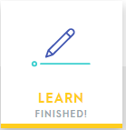
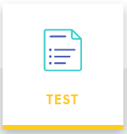
Task 5: QUIZLET SET 快餐
Use FLASHCARDS to write down all the words in characters:
Click “LEARN”, finish 100%
U MUST get every single word correct to be considered as “finish 100%”
Once you finish, you will see this:
Click “MATCH”, make sure you match within 40 seconds.
Click “test”, change your options to:
QUESTION TYPES: START WITH: BOTH
Matching
Multiple choice
True/False
You MUST score 80% or above.

Slide 6
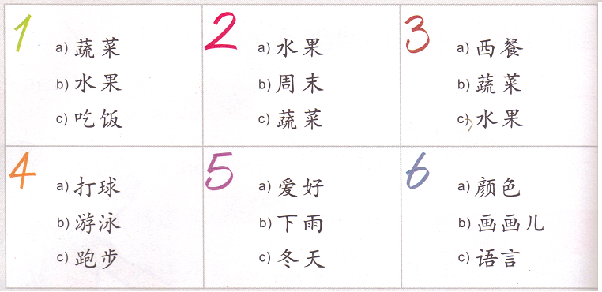
Task 6： listen to Feng lao shi and circle the topic of each dialog.
( 1 B @10:00 am, 3 B @ 1:45 pm)
1.我最喜欢吃水果，我喜欢吃苹果，香蕉等等。
2. 我不太喜欢吃蔬菜，但是我喜欢吃生菜。
3. 我们家每个月都去餐馆吃一次西餐。
4. 我和妹妹每周末都去奶奶家的游泳池游泳。
5. 我不喜欢冬天，因为太冷了。
6. 我特别喜欢画画，比如水彩画，油画和国画等等，我都喜欢。

Slide 7
我
DO NOW: Find out the following words from the dialog:
Or
2 kinds/types
Also
Task 1: Make a preference dialog using this one as reference. You MUST use “or, type, also”
You may talk about the following preference: clothes/hobbies/colors/sports/places……

Slide 8
Task 2: Answer the questions in complete sentences based on your own feelings. You MAY also choose both or neither.

Slide 9
Task 3: True or false and WRITE DOWN THE REASONS.
F
田方住在香港。
Example:_____田方住在北京。 Reason:
Reasons:
1.
2.
3.
4.

Slide 10
 | 包子 火锅huo guo
 | 粥 zhou
Task 4: ENGLISH
Do some research and explain what the following Chinese food items are, for each item, you will need to cover:
Example:
豆浆
1. What is it?
soy milk are both traditional Chinese breakfast foods, served either hot or cold, usually accompanied …
2. How is it cooked?
Boiled.
3. For which meal do Chinese people normally eat it?
Breakfast.
豆浆 dou jiang
油条 you tiao
面条 mian tiao
包子 bao zi
春卷 chun juan
米饭 mi fan
炒面 chao mian
馄饨 hun tun
饺子 jiao zi
炒饭 chao fan

Slide 11
Task 5: QUIZLET SET 快餐
Use FLASHCARDS to write down all the words in characters:
Click “LEARN”, finish 100%
U MUST get every single word correct to be considered as “finish 100%”
Once you finish, you will see this:
Click “MATCH”, make sure you match within 40 seconds.
Click “test”, change your options to:
QUESTION TYPES: START WITH: BOTH
Matching
Multiple choice
True/False
You MUST score 80% or above.

Slide 12
SPEAKING QUIZ:
Find someone have the same A & B to practice with, you MUST come to Feng laoshi to present this period. You will ONLY be responsible for your own grade. You may NOT use your notes.
QUIZLET reference - 09/28 Speaking Task Reference
A: 我们一起去吃_____吧！
B: 你想吃西餐还是中餐？
A: 我想吃_____。
B: 你想吃 food 1 还是 food 2?
A:我想吃_____。
B:你想喝什么？
A:我想喝_____。
早饭/午饭/晚饭

Slide 13
SPEAKING QUIZ: (3 Assigned students)
you MUST come to Feng laoshi to present this period. You will ONLY be responsible for your own grade. You may NOT use PIN YIN as notes.
A: I am hungry, are you guys hungry?
B: Me too, do you want to go to …?
A: I am too lazy, how about we 上网点餐 (shang wang dian can=order online)？
B: Ok, which restaurant do you want to odder from?
A:…(make up a Chinese name)中餐厅。
B:Ok.
On the phone:
C: Hello, 这是…。How may I help you?
A: Hello, we want to 点外卖 (dian wai mai=order to go)。
Order food conversation between A, B and C.
At least 2 hot dishes, 1 cold dish, 1 soup and rice or noodles. (At least 3 questions and 3 answers)
C: Repeat the dishes to confirm the order.
A: Correct. How much?
C: Price.
B: We will be there in about 30 minutes.
C: Ok, thank you. 一会儿见。
A&B: 一会见。

Slide 14
DO NOW: Find the following words in the paragraph and write them down on your paper.
我们全家人都喜欢吃中餐。我们早餐一般吃油条和豆浆。我们晚饭一般吃米饭和炒菜。我们家周末有时候去饭店吃饭。我们下个周末会去一家日本餐厅吃饭。
Entire family: Chinese food:
Breakfast: Normally:
Normally: dinner:
Weekend: sometimes:
Restaurant1: next (weekend):
Restaurant2:
Task 1:
Find 5 items on QUIZLET or your notes for each category.
中餐：
西餐：
快餐：
饮料(2)：

Slide 15
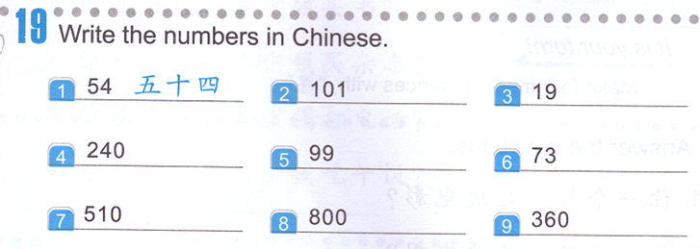
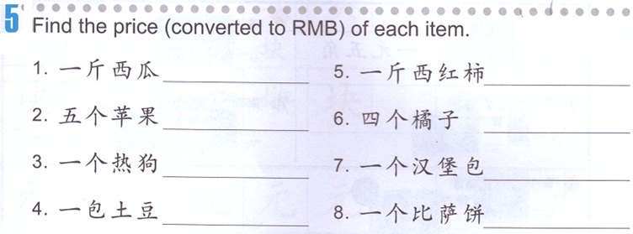
Task 1:
百 = hundred
Example:
260 = 二百六十
1 + hundred + 0 + 1
5 + hundred + 1 + 10
Task 2: Write the price down in Chinese using the examples shown.
Price examples:
3.00 三块
4.5 四块五
6.92 六块九毛二（分）
2.00
1.50
3.50
4.00
1.49
7.32
5.79
12.87

Slide 16
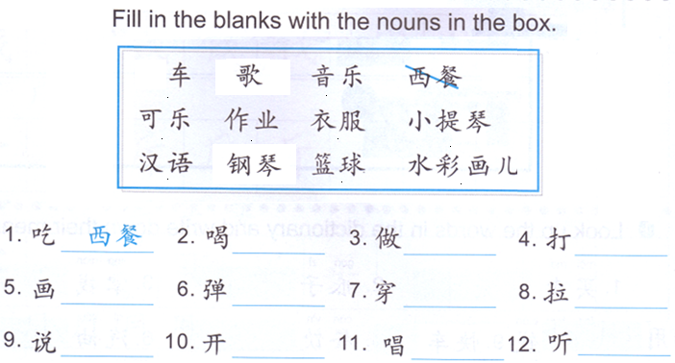
Task 3:

Slide 17
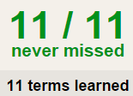
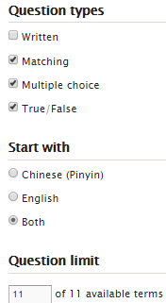
Task 4 QUIZLET instructions – 做饭 (10 words)
Learn-Make sure you finish 100%
Speller-Make sure you finish 100%
Scatter-The time needs to be within 35 seconds.
Test- Create New Test after you change the settings to:
IMPORTANT:
Feng lao shi will check you quizlet completion next Wednesday (10/04)
Make sure you finish the following sets:
做饭
快餐
水果和蔬菜 1
10/10
This number has to be 100
This number doesn’t matter.
10/10
The comment doesn’t matter.
10
This number has to be 12
This number has to be less than 40
10 of 10

