Slide 1
In which sentence would you need the following words?
的，个，您，们
Hello, grandma.
There are 5 people in my family.
That is my book.
Are you guys students?
您
们
个
的

Slide 2
ma
Question word – When you are expecting “yes/no” answer.
吗
Examples:
Are you a student?
2. Is this your book?
3.Are you American?

Slide 3
“是，吗”questions:
Is this your book bag?
This is your book bag ma?
zhè shì nǐ de shū bāo ma?
这是你的书包吗？

Slide 4
shì
“是，吗”answers:
bú shì
Yes/am/is/are
No/am not/is not/are not
是
不是

Slide 5
“是，吗”answers: YES.
Yes, this is my book bag.
shì , zhè shì wǒ de shū bāo .
是，这是我的书包。

Slide 6
“是，吗”answers: NO.
No , this is not my book bag.
bú shì , zhè bú shì wo de shū bāo.
不是，这不是我的书包。

Slide 7
“是，吗”questions:
Is he your dad?
He is your dad ma?
ta shì nǐ de ba ba ma?
他是你的爸爸吗？

Slide 8
shì
“是，吗”answers:
bú shì
Yes/am/is/are
No/am not/is not/are not
是
不是

Slide 9
“是，吗”answers: YES.
Yes, he is my dad.
shì , ta shì wǒ de ba ba .
是，他是我的爸爸。

Slide 10
“是，吗”answers: NO.
No , he is not my dad.
bú shì , ta bú shì wo de ba ba.
不是，他不是我的爸爸。

Slide 11
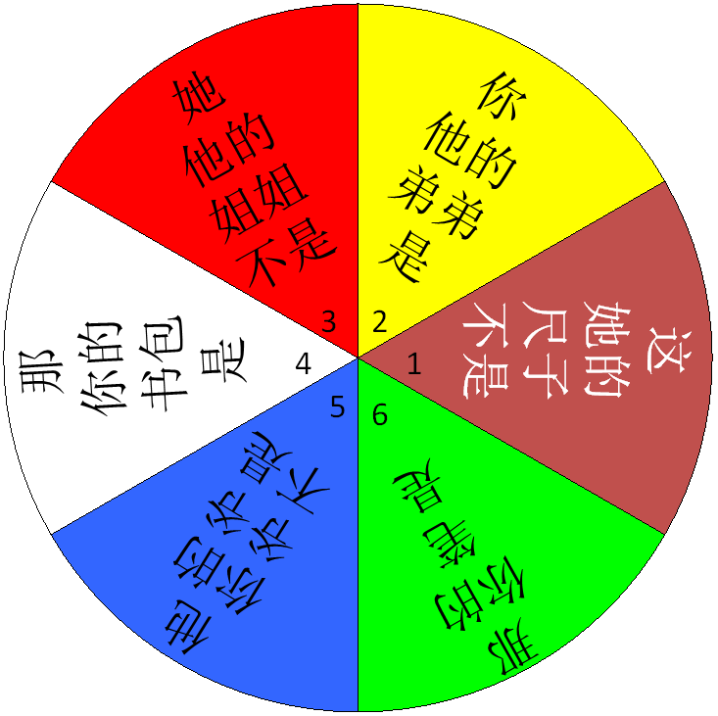
USE Feng lao shi’s colored notes on the promethium board!!!
Speaking Task (QUIZ)
Sentence Structures:
1,2,3
A：___是___ ___吗？
If is 是：
B：是， ___是___ ___。
If is 不是：
B：不是，___不是___ ___。
4,5,6
A：___是___ ___吗？
If is 是：
B：是， ___是 我的 ___。
If is 不是：
B：不是， ___不是我的 ___。

Slide 12
Writing Task: (ON YOUR NOTEBOOK PAPER)
妈妈
1. Make up 4 family members including yourself.
我
2. Make a dialog using the following structures:
妹妹
A: Is this you?
This is you 吗?
B: Yes, this is me.
是, this is me.
A: They are … and …。( 2 members)
They are …和…。
B: Is she/ he your…?
( the other member, needs to be the wrong title)
She/he is your…吗？
A: No, she/he is my…。
不是， She/he is my…。
B: How old are you?
You how old?
A: I am … years old. I number 岁。
Example:
爸爸
A: Is this you？
B: Yes, this is me.
A: They are my mom and dad.
B: Is she your older sister?
A: No, she is my younger sister.
B: How old are you？
A: I am six years old.

Slide 13
妈妈
1. Make up 4 family members including yourself.
我
2. Make a dialog using the following structures:
妹妹
Example:
爸爸
A: Is this you?
B: Yes, this is me.
A: They are … and …。( 2 members)
B: Is she/ he your…? ( the other member, needs to be the wrong title)
A: No, she/he is my…。
B: How old are you?
A: I am … years old.
A: 这是你吗？
B: 是，这是我。
A: 他们是我的妈妈和爸爸。
B: 她是你的姐姐吗？
A: 不是，她是我的妹妹。
B: 你几岁？
A: 我六岁。

