Slide 1
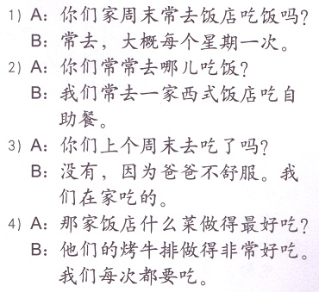
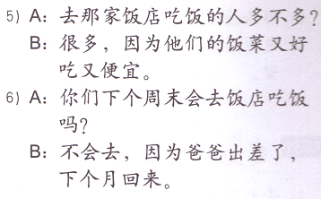
Task 1: Circle the answers based on what you read.

Slide 2
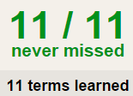
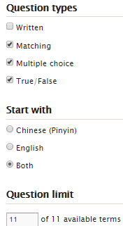
TASK 2 QUIZLET instructions – restaurant food 1 each section is 20%
Learn-Make sure you finish 100%
Speller-Make sure you finish 100%
Scatter-The time needs to be within 35 seconds.
Test- Create New Test after you change the settings to:
笔记notes:
10/10
This number has to be 100
This number doesn’t matter.
10/10
The comment doesn’t matter.
10
This number has to be 12
This number has to be less than 40
10 of 10

Slide 3
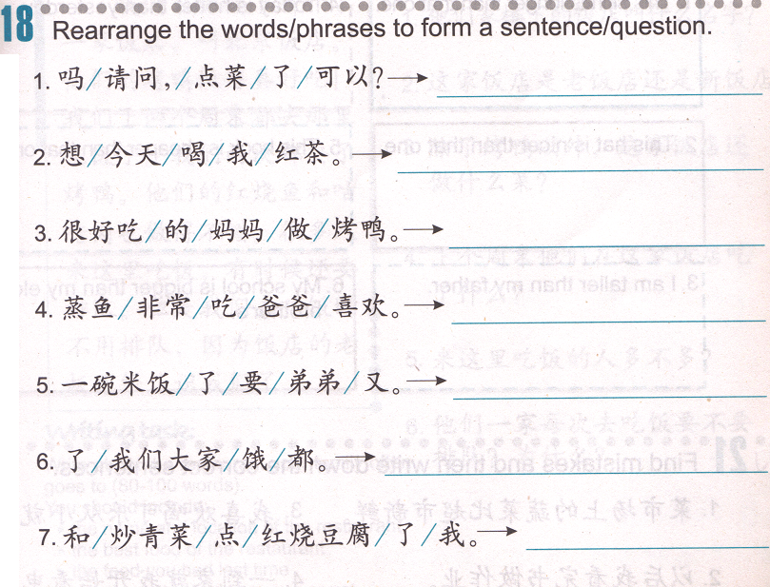
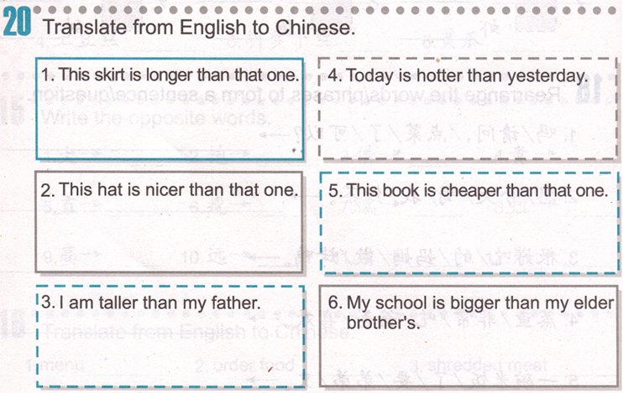
Task 3
Task 4
Item 1 比 Item 2 Adj.

Slide 4
Task 3
Item 1 比 Item 2 Adj.
这条skirt比那条long.
这个hat比那个good
这本book比那本cheap.
我的school比哥哥的big.
Task 4
/你
order
3. Subject + 做的 + food + 很还吃。
The food someone made is tasty.
5. Subject + 又 + V. + 了+ something.
Subject did something again.
order
hungry
order

