Slide 1
Arrange the numbers from the biggest to the smallest.
三十九
四
六十
八十
零

Slide 2
My name is Mary.
wo + jiao + Mary.
叫：It is called
我 Mary。

Slide 3
Your name is Jack.
你叫Jack.
Her name is Lily.
她叫Lily.
His name is Mike.
他叫Mike.

Slide 4
What is your name?
You – ni – 你
Ni + jiao + shen me + ming zi?
你叫 ？

Slide 5
What is his name?
他叫什么名字？
What is her name?
她叫什么名字？

Slide 6
也
Also, too
“也” goes after the subject, before the verb.
Example: I am also 5 years old.
I + also + 5 + years old.
wo + ye + wu + sui.
我也五岁。

Slide 7
Qing wen
May I please ask…
Courtesy expression, goes before any question.
Example: What’s your name?
Qing wen, ni jiao shen me ming zi?
请问，你叫什么名字？

Slide 8
Kahoot.it QUIZ

Slide 9
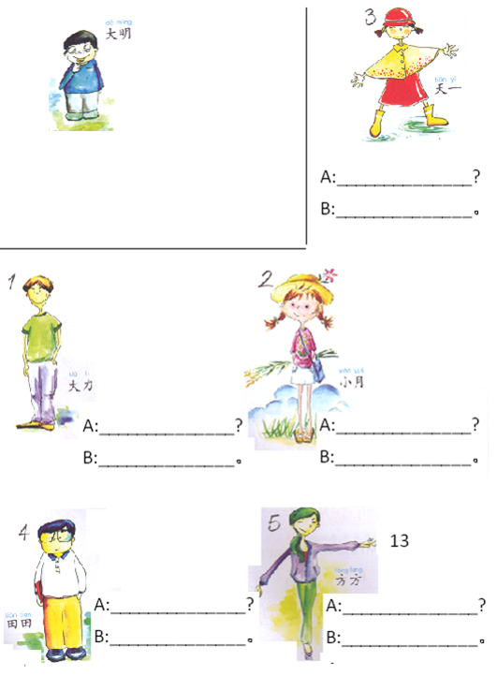
Task 1: A-Write 她/他叫什么名字？
B-Write 她/他叫…。
Task 2:
2 students with the same name and age met for the 1st time. Rearrange the sentences to form a dialog and write it down.
我十五岁，你几岁？
我叫天天。你叫什么名字？
我也叫天天。你几岁？
再见。
认识你我很高心。It was nice meeting you.
你好。
再见。
你好。
我也是。
我也十五岁。
请问，你叫什么名字？
天一
Example:
A：他叫什么名字？
B：他叫大明。
__________________________________
__________________________________
__________________________________
__________________________________
__________________________________
__________________________________
__________________________________
__________________________________
__________________________________
__________________________________
__________________________________
大力
小月
芳芳
天天

Slide 10
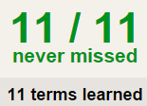
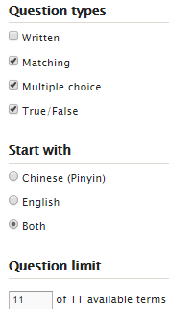
Task 3 QUIZLET instructions – Name each section is 20%
Learn-Make sure you finish 100%
Speller-Make sure you finish 100%
Scatter-The time needs to be within 35 seconds.
Test- Create New Test after you change the settings to:
10/10
This number has to be 100
This number doesn’t matter.
10/10
The comment doesn’t matter.
10
This number has to be 12
This number has to be less than 40
10 of 10

