Slide 1
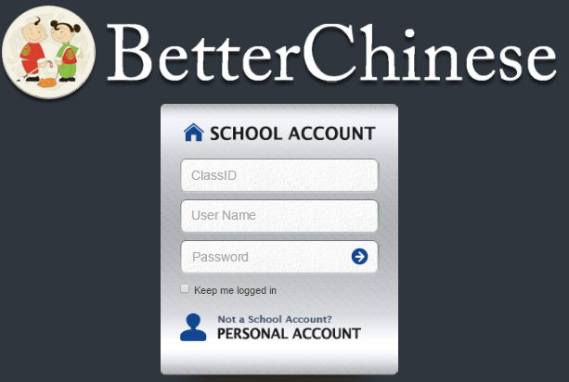
PC/PHONE:
Go to: appweb.betterchinese.com
Select "School Account" tab, not “personal account”
Class ID: APSFengAL1, APSFengAL2, APSFengAL3, APSFengBL1, APSFengBL2, APSFengIB1, and APSFengIB2
User Name: 17s01 (or 17s02, 17s03, etc. all the way to the last student in your list)
Password: 123 [changeable]
iPad:
Discovering Chinese Pro App
Class ID: APSFengAL1, APSFengAL2, APSFengAL3, APSFengBL1, APSFengBL2, APSFengIB1, and APSFengIB2
User Name: 17s01 (or 17s02, 17s03, etc. all the way to the last student in your list)
Password: 123 [changeable]

Slide 2
Go to:
Account Settings
Update Profile
Type your first name & last name
Submit

Slide 3
Go to:
Lessons
Volume 2
第二十二课 : 今天的天气 Lesson 22 : Today's Weather
(See next slide)

Slide 4
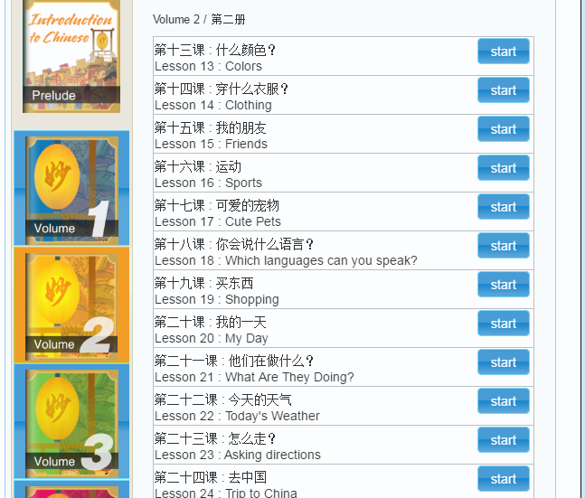

Slide 5
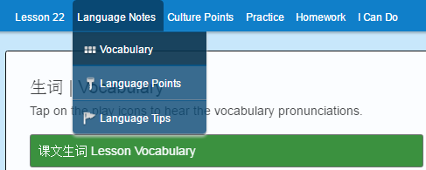
Go to:
Language Notes
Vocabulary

Slide 6
Write down ALL the words in “Vocabulary” here:

Slide 7
Write down ALL the words in “Vocabulary” here:

Slide 8
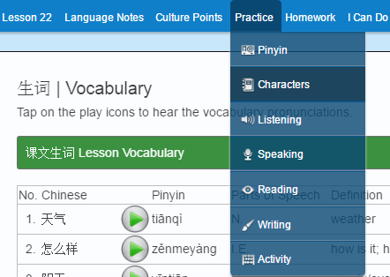
Go to:
Practice
Characters

Slide 9
Write each character at least 1 time.

Slide 10
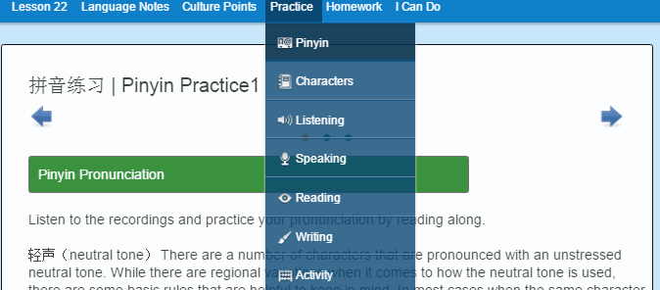
Go to:
Practice
Pinyin

Slide 11
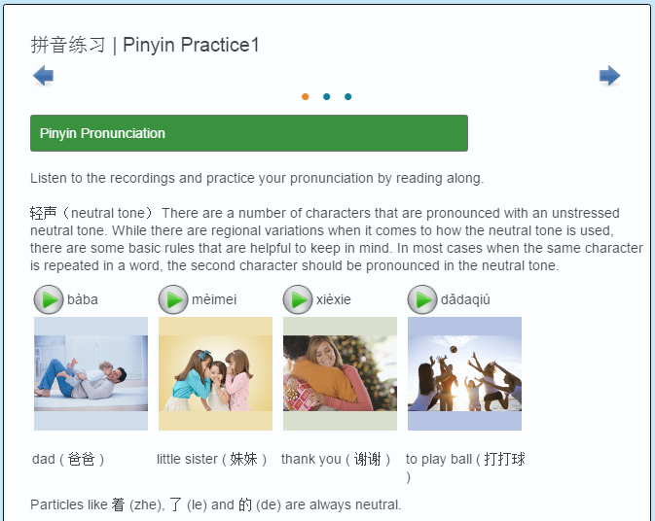
Play all of the pinyin on this page by clicking the “play button”.

Slide 12
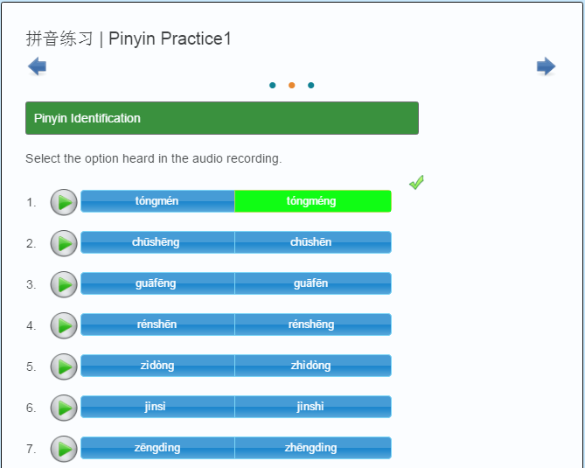
Click on what you heard and check the answers.
Make sure you know why your answers are not correct.
Save answers ( You can always check the answers before saving them)

Slide 13
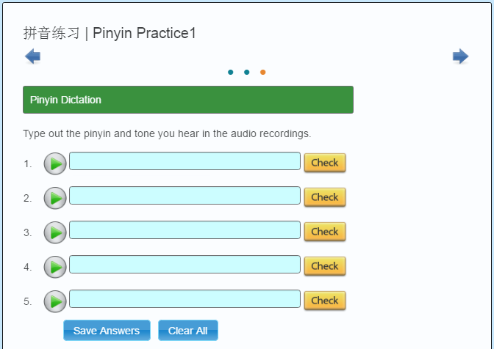
Type what you heard and check the answers.
If you think you heard “ni hao” “ni third tone, hao third tone”, type:
“ni3 hao3” Save answers ( You can always check the answers before saving them)

Slide 14
Go to:
Language Notes
Language Points

Slide 15
Answer the following questions using Language Points as reference:
What does “怎么样” mean?
How do you use it in a sentence? (English & Chinese)
Make your own sentence:(English & Chinese)

Slide 16
Answer the following question using Language Points as reference:
What does “有(一)点(儿) ” mean?
How do you use it in a sentence? (English & Chinese)
Make your own sentence:(English & Chinese)

Slide 17
Answer the following question using Language Points as reference:
What does “可能 ” mean?
How do you use it in a sentence? (English & Chinese)
Make your own sentence:(English & Chinese)

Slide 18
Answer the following question using Language Points as reference:
What does “呢 ” mean?
How do you use it in a sentence? (English & Chinese)
Make your own sentence:(English & Chinese)

Slide 19
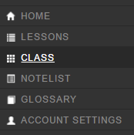
Go to:
CLASS

Slide 20
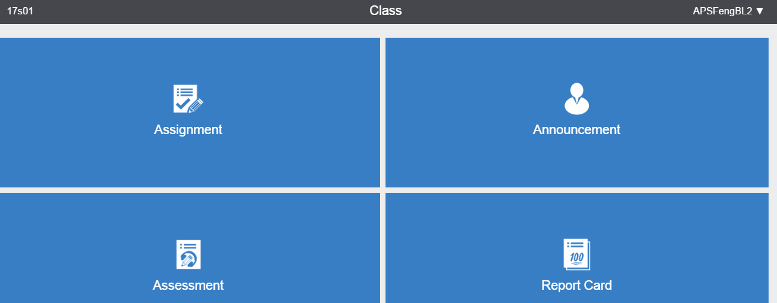
Go to:
Assignment

Slide 21
Finish your Homework
You MUST submit your work by 08/16 (Tuesday), otherwise the system will be LOCKED, you will NOT be able to submit anything after 08/16.

Slide 22
You will need to turn in this package to Ms. Feng when you come here Tuesday
(08/16 Tues)

Slide 23
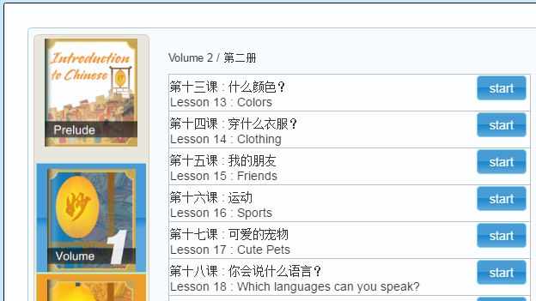
If you finish everything before 1:50 today, go to:
Lessons
Prelude

Slide 24
Read and learn the 9 chapters.

